Slide 1
Topic 3.3 – Measurement & uncertainty
Unit 1

Slide 2
Vocab List
Measurement
Uncertainty
Error
Independent Variable
Dependant variable
Control variable
Accurate
Precise
Reproduce
Controlled
Relationship
Average
Absolute uncertainty
Standard deviation
Analogue
Absolute uncertainty

Slide 3

Learning goals
use mathematical techniques to summarise data in a way that allows for identification of relevant trends, patterns, relationships, limitations and uncertainty, e.g.
- mean
- gradient analysis
- scatterplots (with maximum and minimum trendlines and R2)
- propagate random error in data processing to show the impact of measurement uncertainties on the final result - apply simple treatment of error analysis, e.g. for functions such as addition and subtraction, absolute uncertainties should be added, for multiplication, division and powers, percentage uncertainties should be added
- calculate the measurement uncertainties in processed data, including the use of absolute uncertainties of the mean (Formula: ) and percentage uncertainties
- calculate the percentage error, when the experimental result can be compared with a theoretical or accepted result (value)
- discriminate between absolute uncertainty and percentage error

Slide 4
Scientific notation
Scientific notation is used to represent numbers in a format that is easy to read. It is particularly useful for really big numbers and really small numbers.
You are familiar with decimal notation → e.g. 2400, 0.56, 0.00004
Scientific notation uses indices to show the magnitude of the value. For example,
2400 could be written as 2.4 x 10³
0.56 = 5.6 x 10⁻¹
0.00004 = 4 x 10⁻⁵

Slide 5
Check your understanding: scientific notation
Convert the following values to scientific notation.
(a) 0.00002
(b) 130 000
(c) 0.094
Convert the following values to decimal notation.
(d) 3.07 x 10⁴
(e) 8 x 10⁻⁶

Slide 6
Significant figures
Rules:
Do not count 0 after a decimal point, but before integers. 0.00234 has 3 significant figures.
Count 0 after integers as significant, even if in a decimal or in scientific notation
0s are significant if surrounded by integers on both sides e.g. 24040 has 5 sig figs
Match number of significant figures to other measurements or figures, so that you are consistent. E.g. if mass = 0.21g, there are 2 significant figures, so your uncertainty should also have 2 significant figures.

Slide 7
Check your understanding: Significant figures
Determine the number of significant figures for each of the following values:
(a) 2
(b) 2000
(c) 0.0023
(d) 7.32
(e) 7.02
(f) 5.00

Slide 8
Conducting Experiments: Variables
Independent variable – the variable in an experiment you change to see how it changes other variables. It is not dependant on any other variables in the experiment
Dependant variable – the variable you measure. It is the variable you are trying to investigate
Controlled variables – variables that are kept the same. This allows us to accurately see the relationship between the independent and dependant variables

Slide 9
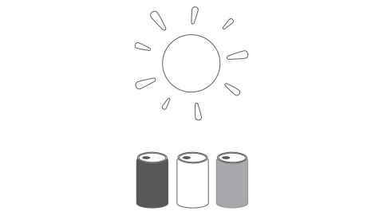
Example
An experiment was conducted to investigate the effects of colour on the absorption of heat using water filled cans placed in the sun. Thermometers were placed in the cans to measure the heat absorbed.
Independent variable
Dependant variable
Control variables –

Slide 10
Conducting Experiments
A large amount of control is needed when conducting an experiment to make sure we can accurately measure the relationship between the variables.
Being aware of the control variables are therefore really important – we don’t want anything to change our results as they would reduce accuracy and make it hard to re-create experiments.
This ability to reproduce experimental results is a key part of science – if you can’t reproduce someone else’s results, their experiment might not be providing useful/accurate information!
We also need to be aware of sources of error and uncertainty

Slide 11
Experimental results
Are they Accurate?
Are they Precise?
Notes:
Error is what causes values to be different when a measurement is repeated.
Errors can be random or systematic (shifts all data one way) e.g. all weights out 0.76g cos you didn’t calibrate
Random error varies unpredictably = equipment insensitivity, difficult to define (lengths etc- stuff you make decisions about)

Slide 12
Experimental results
Are they Accurate?
Are they Precise?
Accuracy is the ability to link to a standard – is it right? How close are measurements to true value?
Measurements associated with accuracy:
Averages / means
Degrees of accuracy:
Uncertainty – the range of values in which the true value lies; addresses error
Errors – random or systematic and percentage error (how far away from 100% is your measurement?)
Precision is the ability to reproduce the results – can I get the same results more than once?
Measurements associated with precision:
Using digital measurement devices
Significant figures (how many decimals to include)
Both need to be considered in experimental work
Notes:
Error is what causes values to be different when a measurement is repeated.
Errors can be random or systematic (shifts all data one way) e.g. all weights out 0.76g cos you didn’t calibrate
Random error varies unpredictably = equipment insensitivity, difficult to define (lengths etc- stuff you make decisions about)

Slide 13
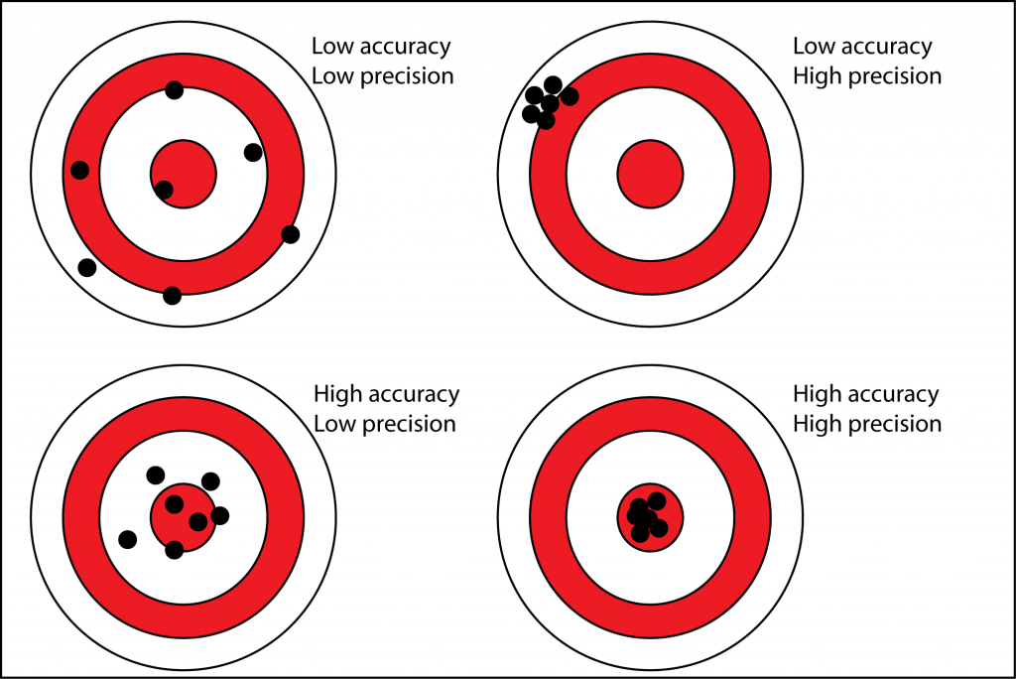

Slide 14

Errors & Uncertainty - Equipment
Volume
Q1: Calculate the relative uncertainty of a 100 mL measuring cylinder with an uncertainty of 2 mL.
Q2: 50 mL is measured using the above measuring cylinder. Identify the relative uncertainty, and express it as an absolute uncertainty.
Uncertainty written on measuring cylinder
250mL ± 0.2mL at 20ºC
This means that at any measurement e.g. 100mL of water, the volume might be 99.8mL through to 100.2mL.
We might want to express this uncertainty as a percentage, aka relative uncertainty:
Is this in your data book?
Notes:
0,2mL is error at 20oC, but at SLC, this would be increased, as volume of water would increase with extra heat.

Slide 15
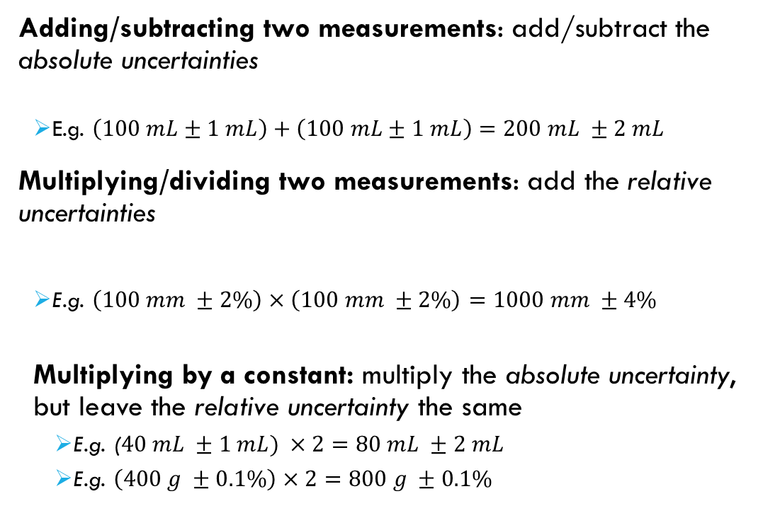
Errors & Uncertainty - Equipment
Volume
Adding/Subtracting/Multiplying Uncertainties
Q Place 40 mL of water into your beaker using the measuring cylinder. State the volume of water in your beaker.
Q Pour an additional 40 mL of water into your beaker. State the volume of water in the beaker.
Adding/subtracting two measurements: add/subtract the absolute uncertainties
E.g. $\left(100 mL±1 mL\right)+\left(100 mL±1 mL\right)=200 mL ±2 mL$
Multiplying/dividing two measurements: add the relative uncertainties
E.g. $\left(100 mm ±2\%\right)×\left(100 mm ±2\%\right)=1000 mm ±4\%$
Multiplying by a constant: multiply the absolute uncertainty, but leave the relative uncertainty the same
E.g. ($40 mL ±1 mL) ×2=80 mL ±2 mL$
E.g. $\left(400 g ±0.1\%\right)×2=800 g ±0.1\%$

Slide 16
Errors & Uncertainty
Mass
Scales can be accurate to 2, 3 or 4 decimal points. On a 2 decimal scale, the measurement is only accurate to 1 decimal place, with the second decimal rounded. This means the uncertainty is ± 0.01g
On 4 decimal point scale, uncertainty is ± 0.0001g
Q: 2.50 g of CuSO₄ is weighed using a balance that goes to 2 decimal places. State the mass of copper sulfate.
Q: The same sample of CuSO₄ is weighed using a balance with 4 decimal points. The mass is recorded as 2.5000 g. State the mass of copper sulfate.
Q: Identify which mass is more precise.

Slide 17
Errors and uncertainty
Estimating
Q: Draw a line 24.25 cm long with a 30 cm ruler. State the length of the line.
Q: Draw a line 24.25 cm long with a 1 metre ruler. State the length of the line.

Slide 18
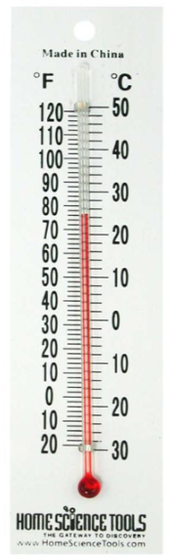
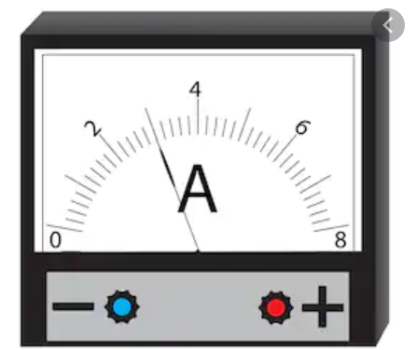
Errors and uncertainty
Estimating
Q: Measure a line 24.25 cm long with a 30 cm ruler. State the length of the line.
Q: Measure a line 24.25 cm long with a 1 metre ruler. State the length of the line.
Using half the smallest measurement as the uncertainty is common practice, and applies to all analogue equipment.
Analogue means non-digital, e.g. a thermometer, ammeter

Slide 19
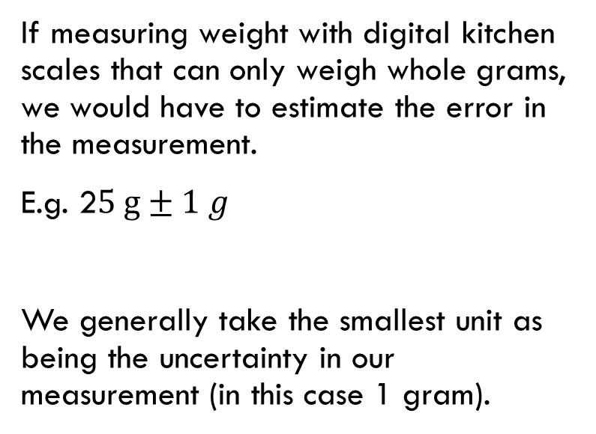
Errors and uncertainty
Q: Weigh __ g of NaCl on your weigh balance. State the mass of NaCl.
Q: Determine the relative uncertainty for the mass you weighed.
Estimating
If measuring weight with digital kitchen scales that can only weigh whole grams, we would have to estimate the error in the measurement.
E.g. 2$5 g±1 g$
We generally take the smallest unit as being the uncertainty in our measurement (in this case 1 gram).

Slide 20

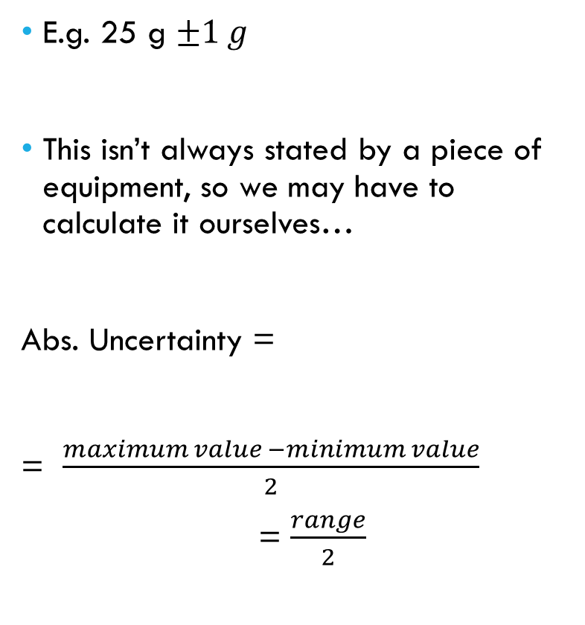
Errors & Uncertainty
Absolute uncertainty
Absolute Uncertainty
Absolute uncertainty
E.g. 25 g $±1 g$
This isn’t always stated by a piece of equipment, so we may have to calculate it ourselves…
Abs. Uncertainty =
= $\frac{maximum value −minimum value}{2}$
= $\frac{range}{2}$
Q: A sample of water is weighed three times, with the results displayed below. Determine the mass of water.
Sample Number | Mass (g)
1 | 100.04
2 | 100.07
3 | 100.11
Is this in your data booklet?

Slide 21
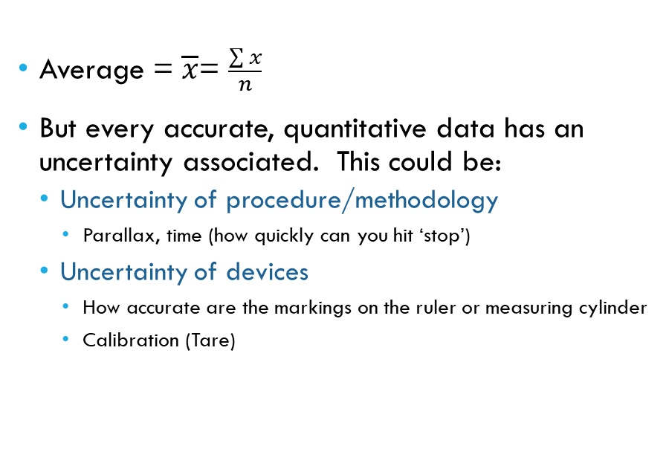
Errors & Uncertainty – defining accuracy
Average
Average = $\overline{x}$= $\frac{\sum{x}}{n}$
But every accurate, quantitative data has an uncertainty associated. This could be:
Uncertainty of procedure/methodology
Parallax, time (how quickly can you hit ‘stop’)
Uncertainty of devices
How accurate are the markings on the ruler or measuring cylinder
Calibration (Tare)
Parallax uncertainty is error associated with reading a device and your perspective (are you looking at the volume of a measuring cylinder from eye-level, or are you looking down on it?)
Notes:
Calculate average mass of fuel and average delta T and average weight of water. We will use these

Slide 22
Relevant textbook chapters
Section Review 10.1 through to Section Review 10.6 and the chapter review.

